Slide 1
HCI Final Project
Ahmaad Jackson

Slide 2

Empathy Map
First, in order to gather information on the product (Google Maps) I had to put myself in the user’s shoes and ask what improvements they would want in the app
What we think/feel
Users think that they might be late for work
Users want the GPS to be accurate
Users want the navigation to provide them with safe routes (no traffic, crime, unknown roads)
What we see
Is my route correct?
Is the map updated?
Can I reroute? I see too much traffic ahead
What we hear
What does your boss say about your attendance?
What do angry drivers say about the app?
Do people say that our app is accurate?

Slide 3
Empathy Map (Continued)
What we say & do
Would I recommend maps when users need to drive with limited time?
How useful is it?
Who could I recommend Maps to?
Gains
Will this app help me lower a user’s time to the destination?
Will this app properly display vehicle & traffic navigation?
Will this app help improve driver safety?
Pains
Users fear from being fired from because the GPS miscalculated their route/didn’t update for closings
Users fear getting into an accident
Users fear getting stuck in a traffic jam

Slide 4


Persona- Mia K.
Age: 20
Occupation: Design Intern, Student
Location: Brooklyn, NY
Bio:
Mia is a junior at The New School, majoring in Strategic Design & Management with a minor in FIne Arts.
As a student, she chose her college major because it combines her passions: creativity & business.
She likes meeting new people, but prefers to have space to herself at the end of the day.
Goals
Finish college
Start art business (future)
Travel
Stay healthy & fit
Frustrations
Impatient, Hates traffic & crowding
Hobbies & Interests
Traveling, Blogging, Cooking, Nature
Words to Describe Her
Opportunistic, Creative, Self-Motivated, Perceptive
Favorite/Most Used Apps
Google Maps, Instagram, LinkedIn, Lyft, Gmail
Notes:
About
Here we provide an example of an archetypical user of Google Maps in order to show what type of person would regularly use the improved features of Google Maps
This user primarily uses transit and walking in NYC to get to places, therefore the easy switching between transportation modes would be very useful
She hates traffic and crowding, therefore she would like to know if a route is blocked off or if there’s a traffic jam/train delay
She uses Lyft regularly, and drivers would like a more accurate indication of when to turn

Slide 5
User Stories
User Story 1
As a user, I want the GPS to more efficiently predict when my car should turn so that I turn when I need to rather than making a sharp turn at the last minute.
User Story 2
As a user, I want the GPS to quickly update road information so that I do not get stuck in a traffic jam or waste time driving to a closed route.
User Story 3
As a user, I want the GPS to quickly update when switching from driving directions to walking directions so that I can reach my destination without getting confused on the duration of the travel.
User Story 4
As a user I want the GPS to update the transit routes so that I know what bus or train to take.
User Story 5
As a user I want the map to provide more accurate outlines for buildings and landmarks so that I know exactly where to go.
I added user stories in order to provide a natural, discussion-based perspective of the improved features of Maps

Slide 6
About the User Interface
The sketches and wireframes take the ideas from the user stories and provide a rough draft visualization of their input as features of Maps
The flows (flowchart/navigation flow) show the steps and interactions that the user needs to take in order to reach the features that they need in the app
The prototypes show the early & late working functions of the application features, and the actual navigation of the menu items
There’s the low fidelity (sketch), mid fidelity, & high fidelity prototypes

Slide 7
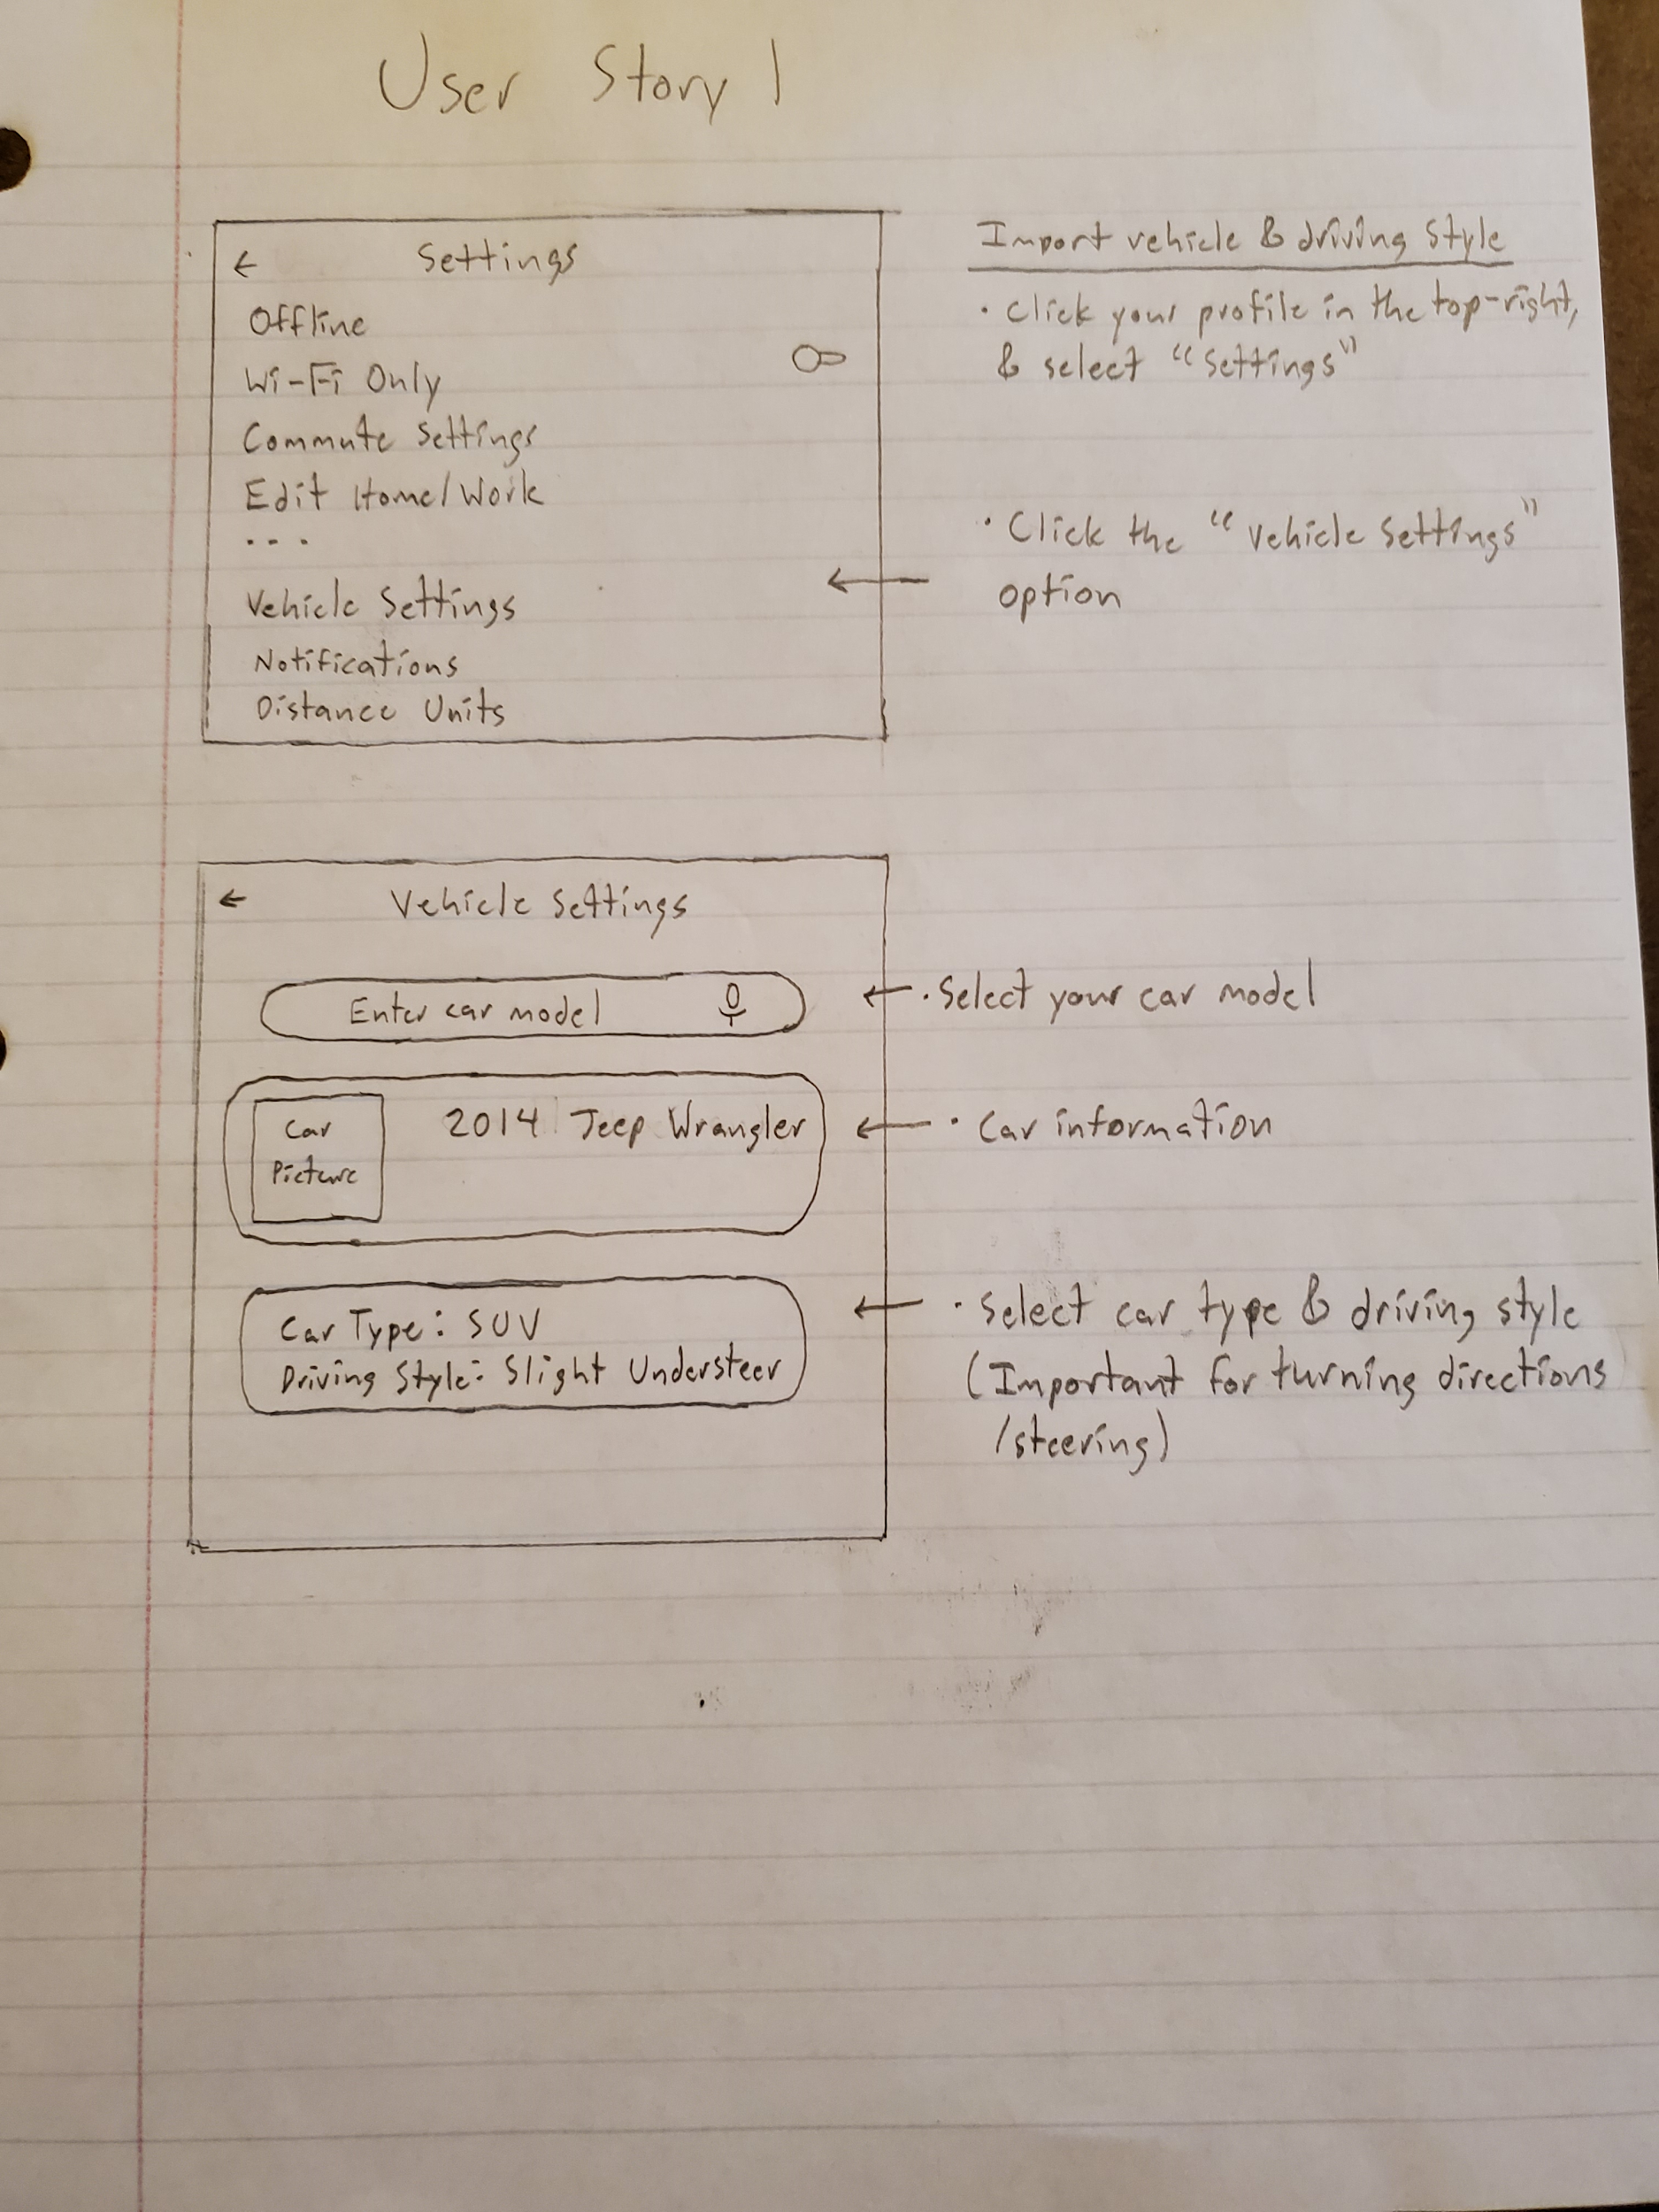
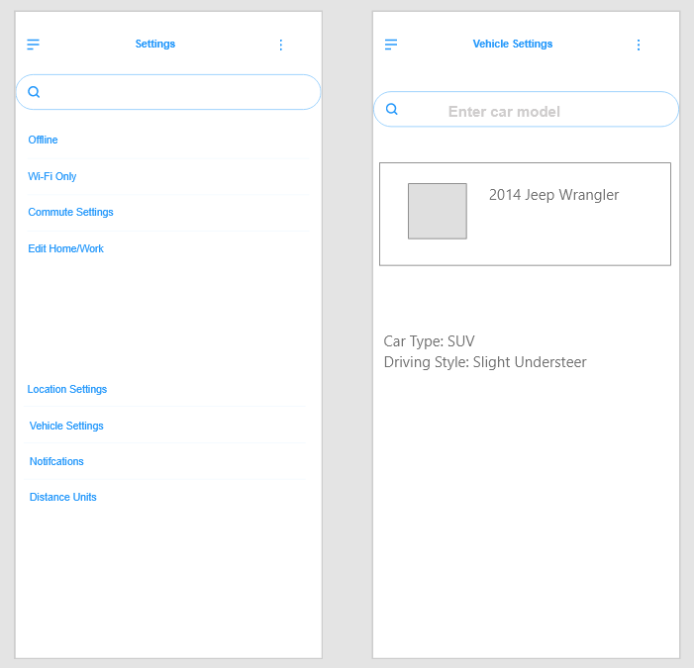
UI Sketch & Wirerame Part 1

Slide 8
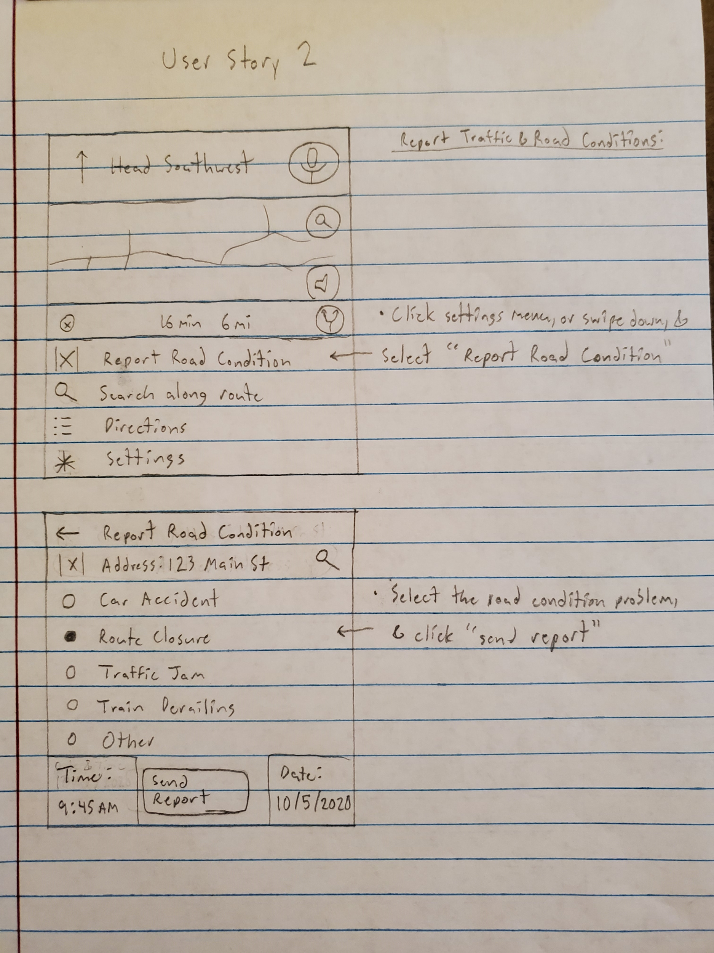
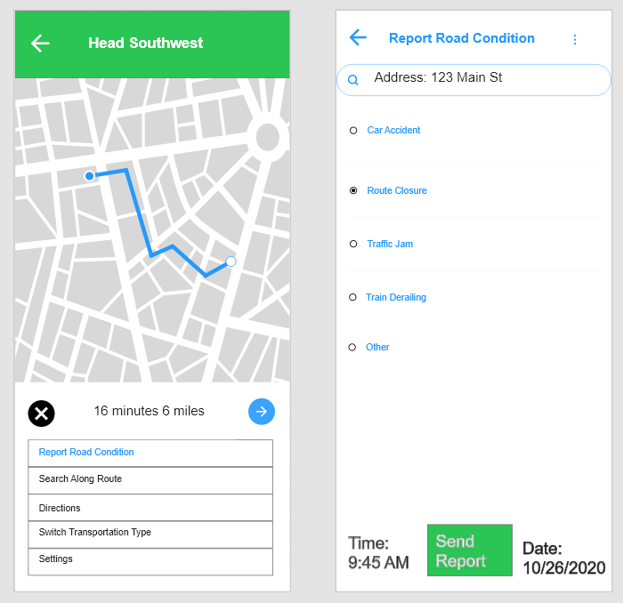
UI Sketch & Wirerame Part 2

Slide 9
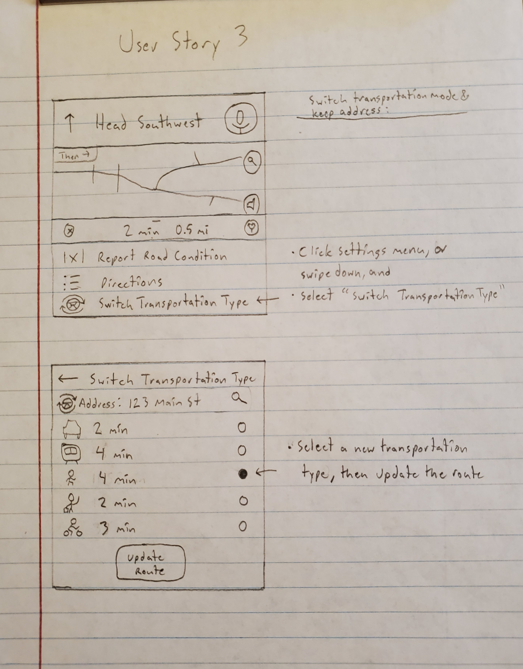
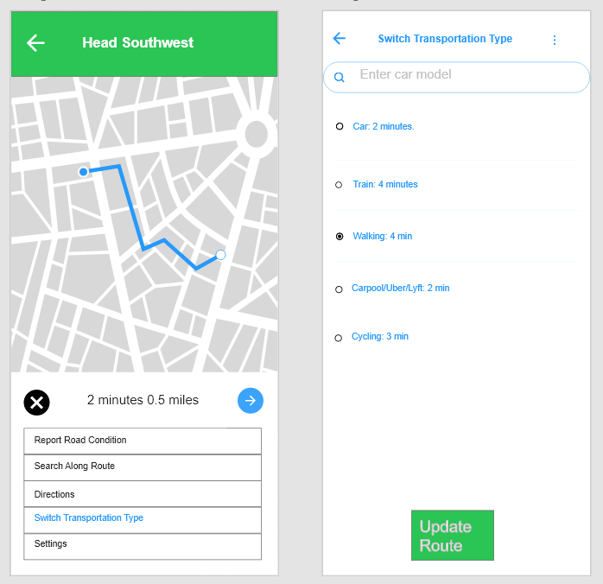
UI Sketch & Wirerame Part 3

Slide 10
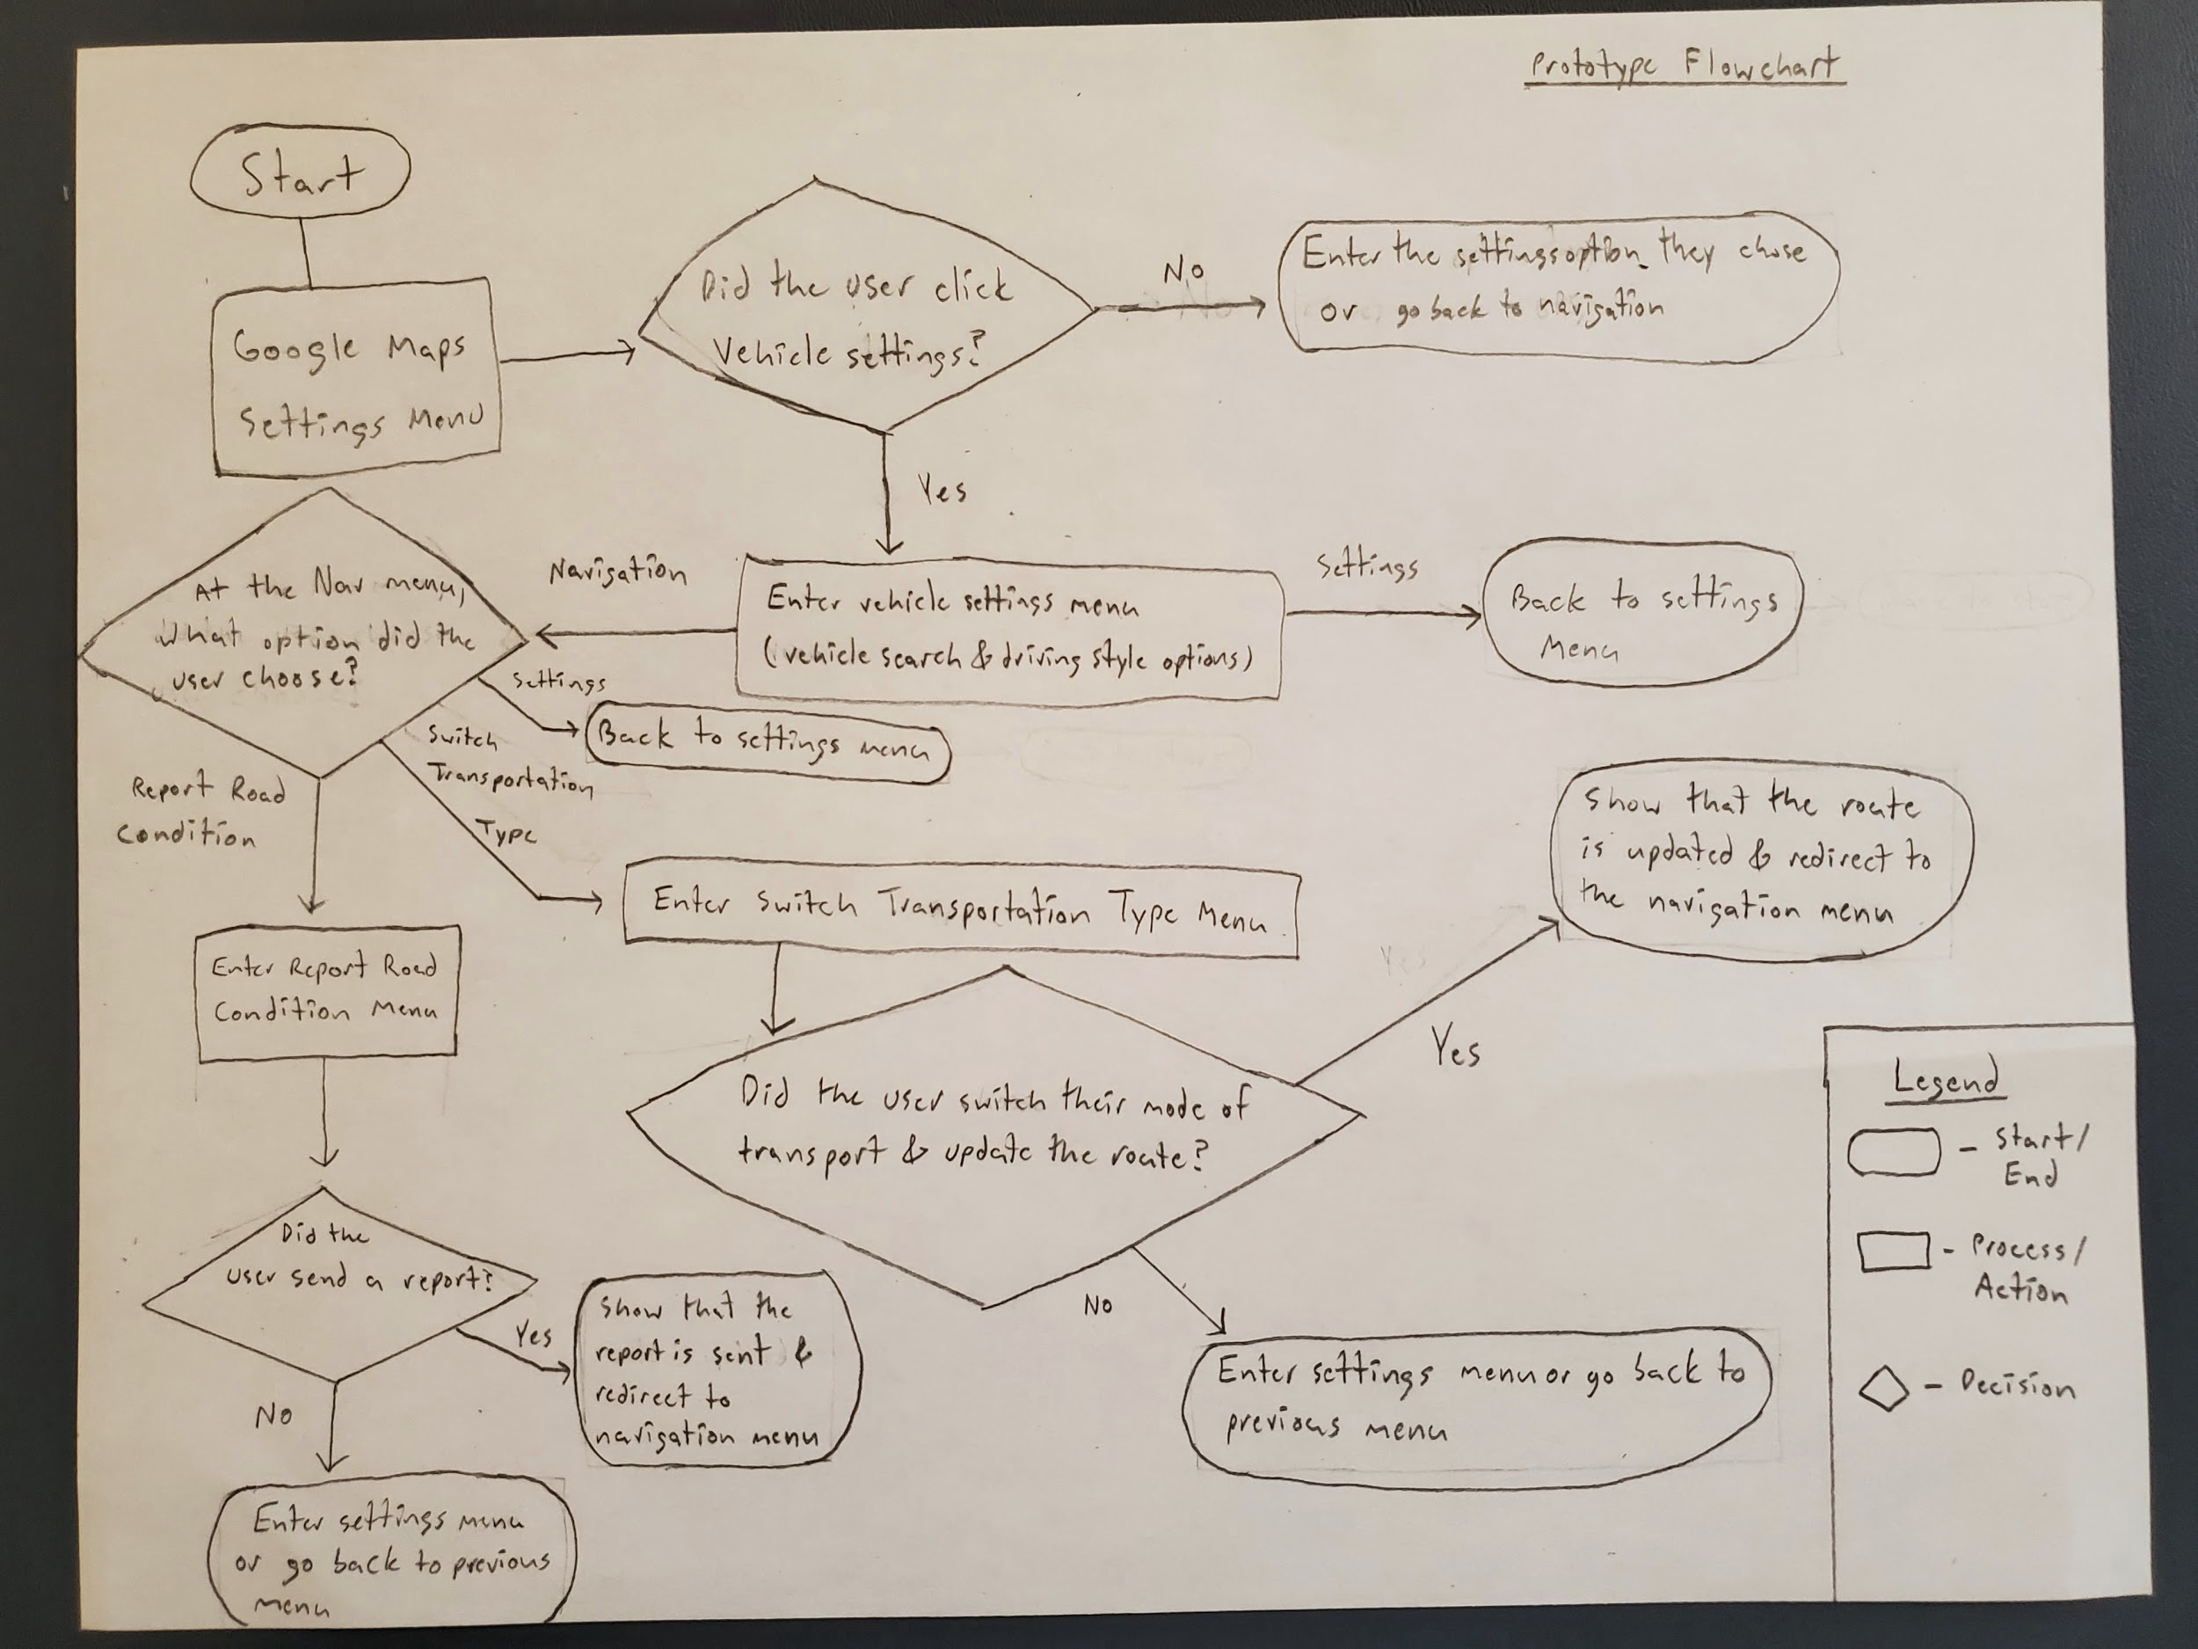
Prototype Flowchart
Here is a flowchart showing the flow pattern of the updated Maps features

Slide 11

Flows in the Prototype
Here is a video showing how the prototype flows
Navigation points are highlighted to show where the user clicks

Slide 12
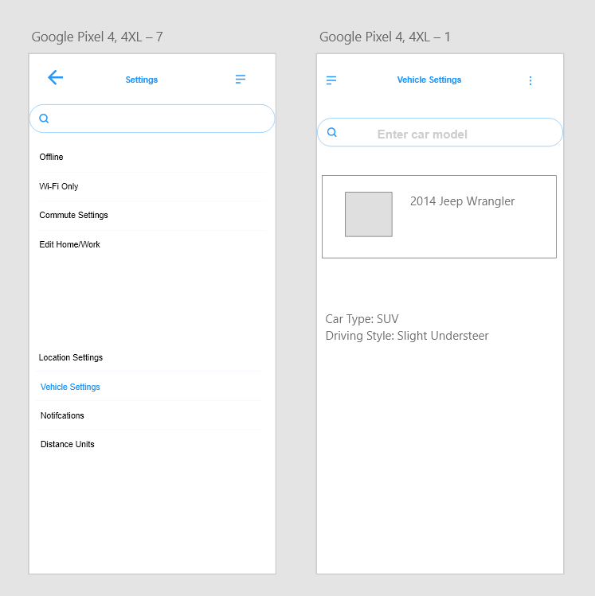
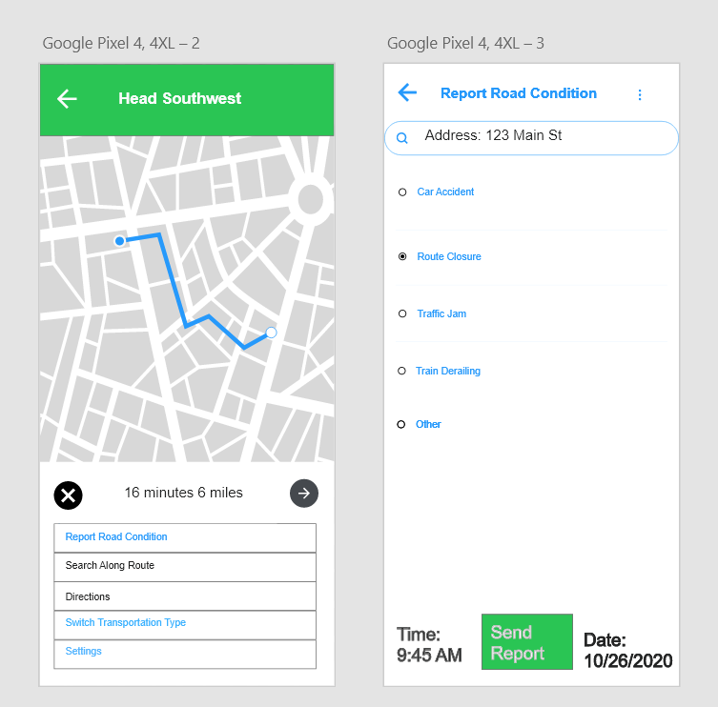
Mid-Fidelity Prototype:
Vehicle settings, Navigation, & Road Condition

Slide 13
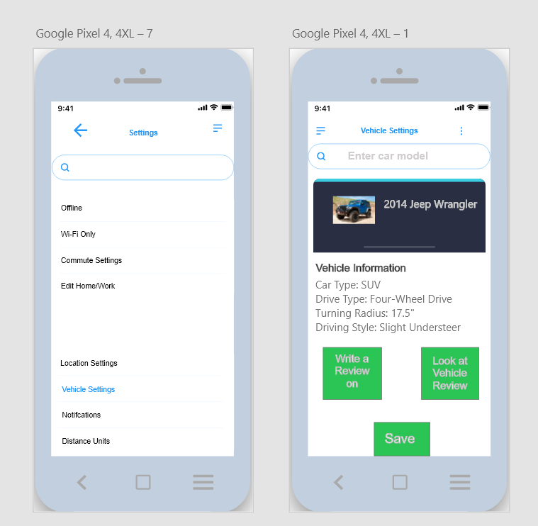
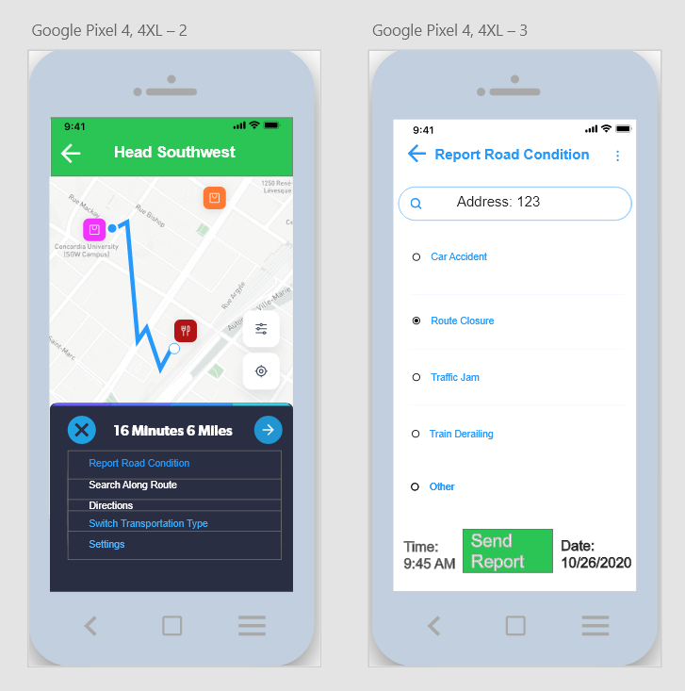
High-Fidelity Prototype:
Vehicle settings, Navigation, & Road Condition

Slide 14
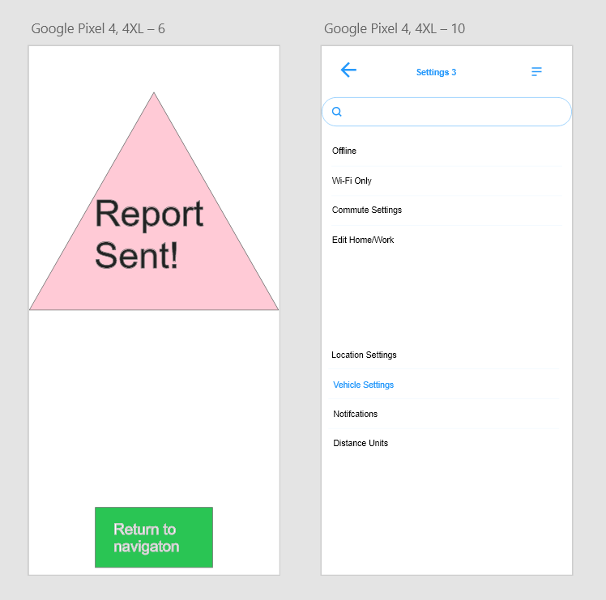
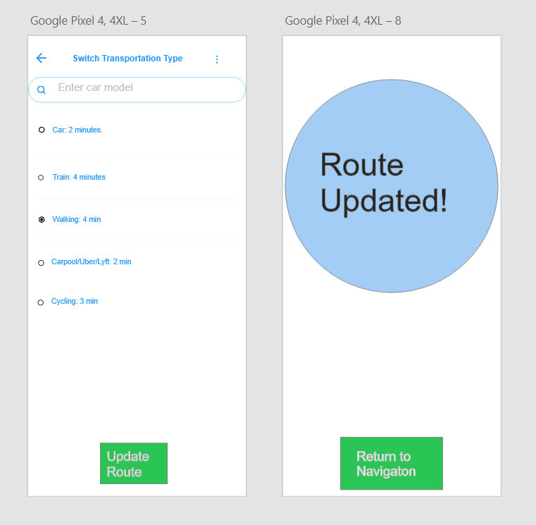
Mid-Fidelity Prototype:
Road COndition (ReporT Sent) & Switch Transportation Type

Slide 15
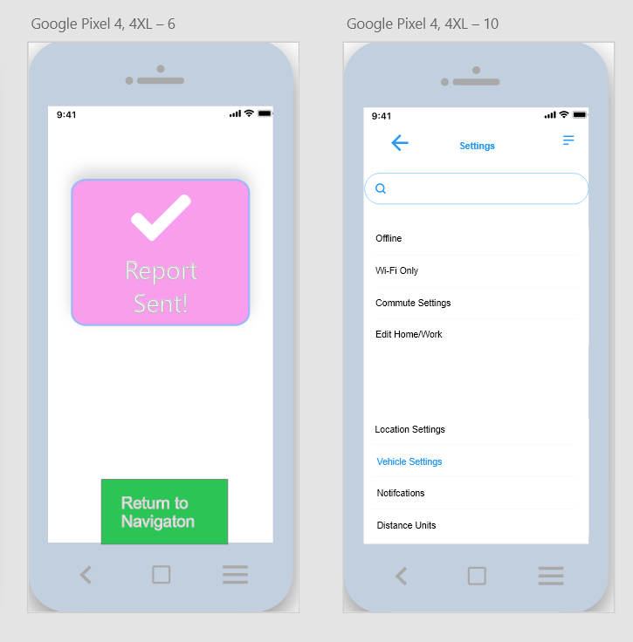
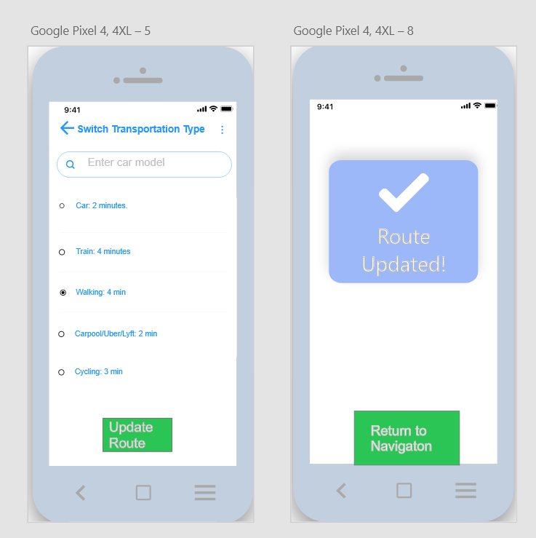
High-Fidelity Prototype:
Road COndition (ReporT Sent) & Switch Transportation Type

Slide 16
Usability Test Findings
Findings and Recommendations
Overall, the participants found the prototype to be detailed, but the navigation could be a little more straightforward.
They like the concept, overall navigation, and the improvements to Google Maps that I suggested with the new prototype
Potential improvements include
Functional search buttons
Easier navigation between settings menu and navigation options
Nicer User Interface/More Modern-Looking

Slide 17
Updated Prototype FLow
Link to High-Fidelity Prototype
https://xd.adobe.com/view/de8218e4-e1c9-4478-aa2f-db41fcad58d3-8bd1/?fullscreen&hints=off

Slide 18
Thank You!

